Slide 1
Intro to DevOps Achieving faster delivery while lowering risk
Notes:
For questions, please contact:
George Salhani
Brittany Hurley
Patrick Heard
Dave Schindler

Slide 2
Purpose
Show how development teams can deliver software faster to clients, but also achieve greater:
Quality
Security
Accessibility
If teams can work on projects quicker without sacrificing compliance, then we can deliver more initiatives on the Investment Plan without hiring more staff.
Why go faster?

Slide 3


Faster, safer, better
TOYOTA
1978
How did Toyota beat the North America auto industry on quality and production?
43
cars produced per employee
GM
1979
14.9
cars produced per employee

Slide 4
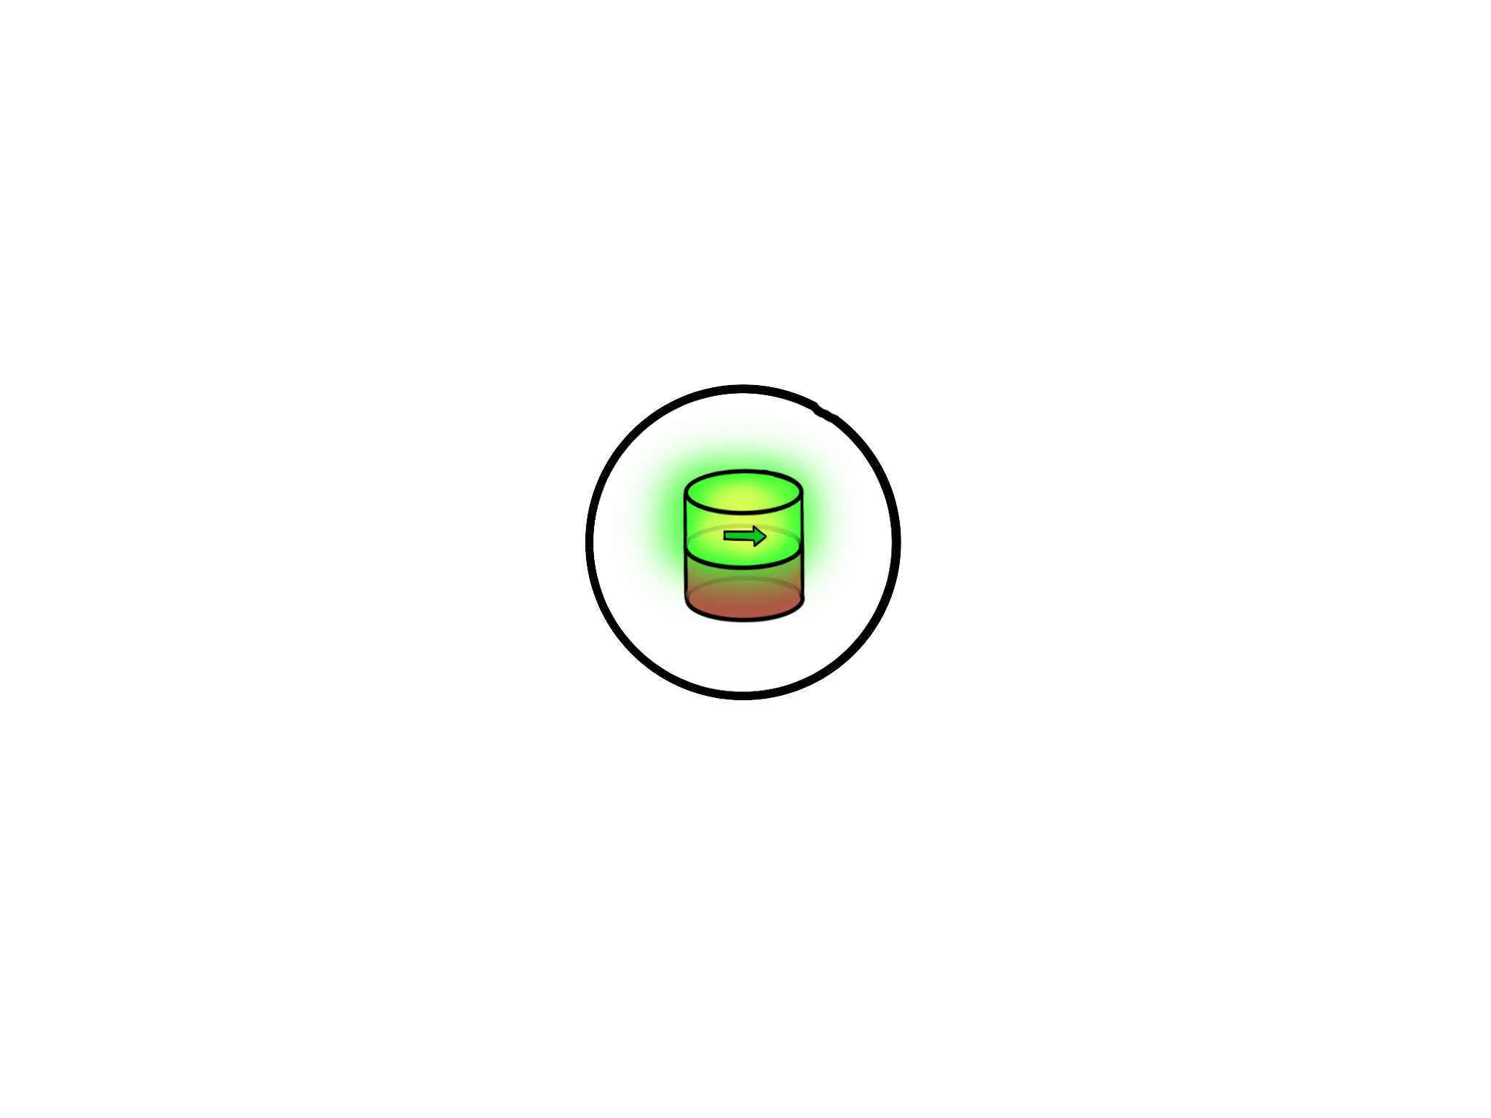
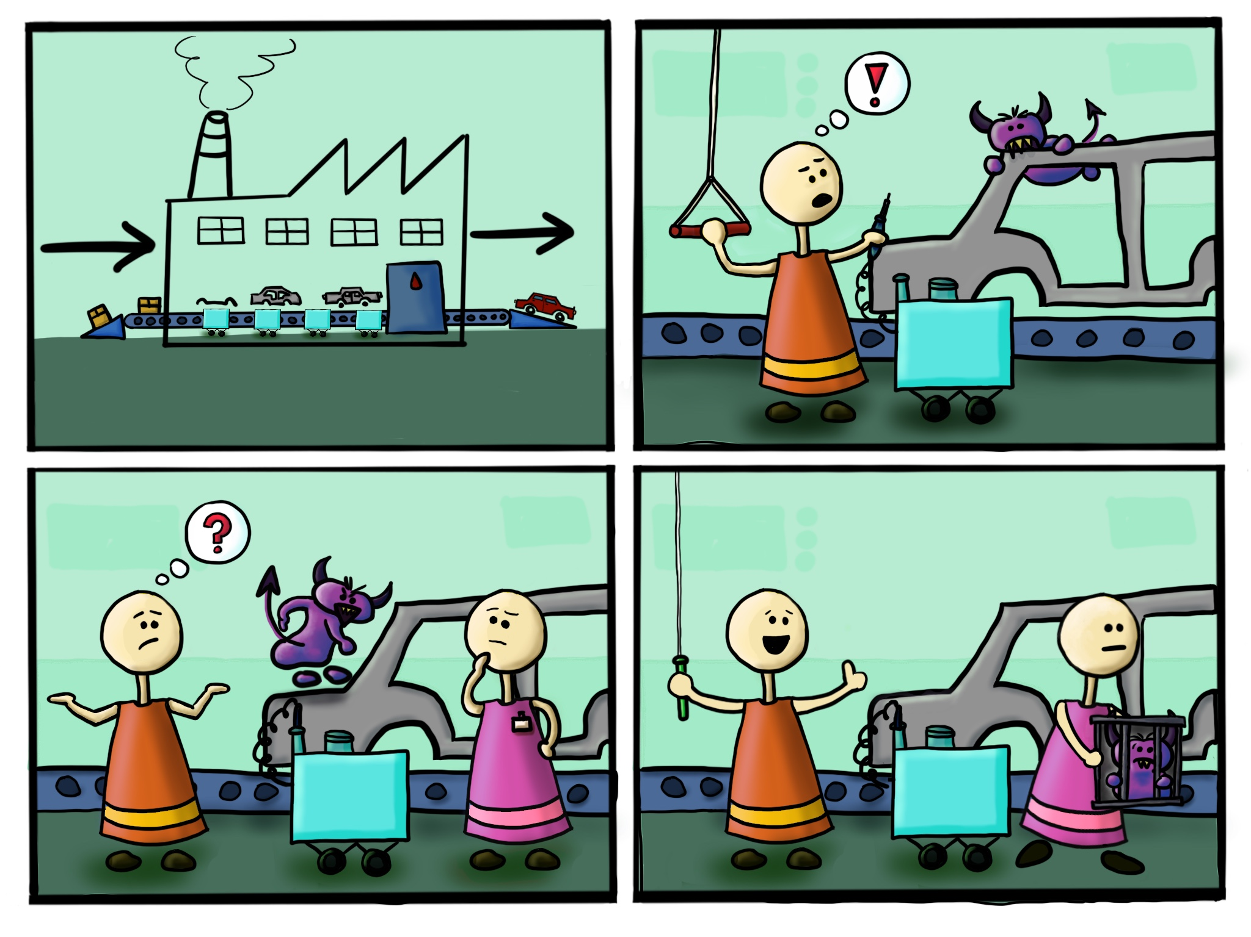
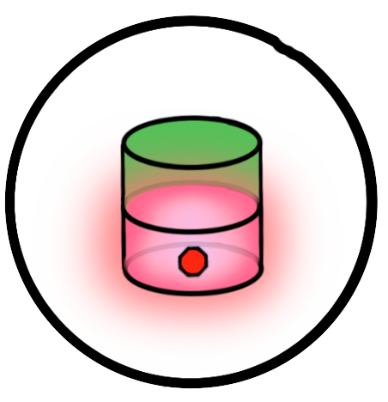
Andon
System

Slide 5

Andon is a fail-safe
Quality is monitored at each step in the production line:
Defects are prevented from progressing downstream, where the effort to fix the defect increases exponentially
Employees become aware of potential defects and learn how to find or prevent them
Is there an equivalent to the Andon System for software projects?
Of course!
(That’s why we’re here after all )

Slide 6
CI/CD Pipelines
Continuous Integration & Continuous Delivery (CI/CD) Pipelines allow teams to automate the risky manual tasks needed to transform Source Code to a shippable product.
Each task is scripted, committed to source control, and repeated every time a change is introduced to a system
If a change doesn’t pass compliance checks, the pipeline stops and will not move the change to production

Slide 7
Demo
We’ll demonstrate Continuous Integration & Delivery (CI/CD):
A developer uploading new code for a website
The upload triggering a deployment process
Failed test results cancelling the deployment
The developer reuploading fixed code
The code passing the tests and deploying to production

Slide 8
Demo
Notes:
We created a simple service. This service is supposed to allow a user to Search for services offered by the GC, but some code made its way to production and the service is broken.
This happens now, because the processes we use for determing what is eligible for production are manual, and error prone.

Slide 9
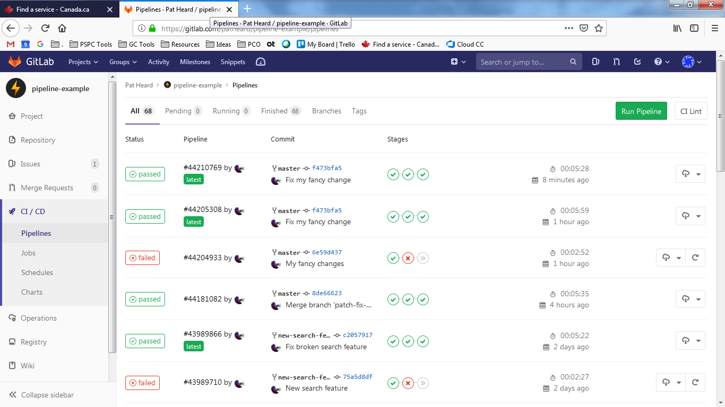
Demo
Notes:
This is GitLab.com.
Wont take too much time to dive into this platform because we don’t want this to be about specific tools.
This is a dashboard showing every single time the CI/CD pipeline ran.
Everyone can get a view of the history of changes, see when there are failures, and get real time precision tracking of releases.
- So lets say a new developer is working at their workstation on a Change Request, and they feel like thy’re ready to commit their code and go live to production.

Slide 10
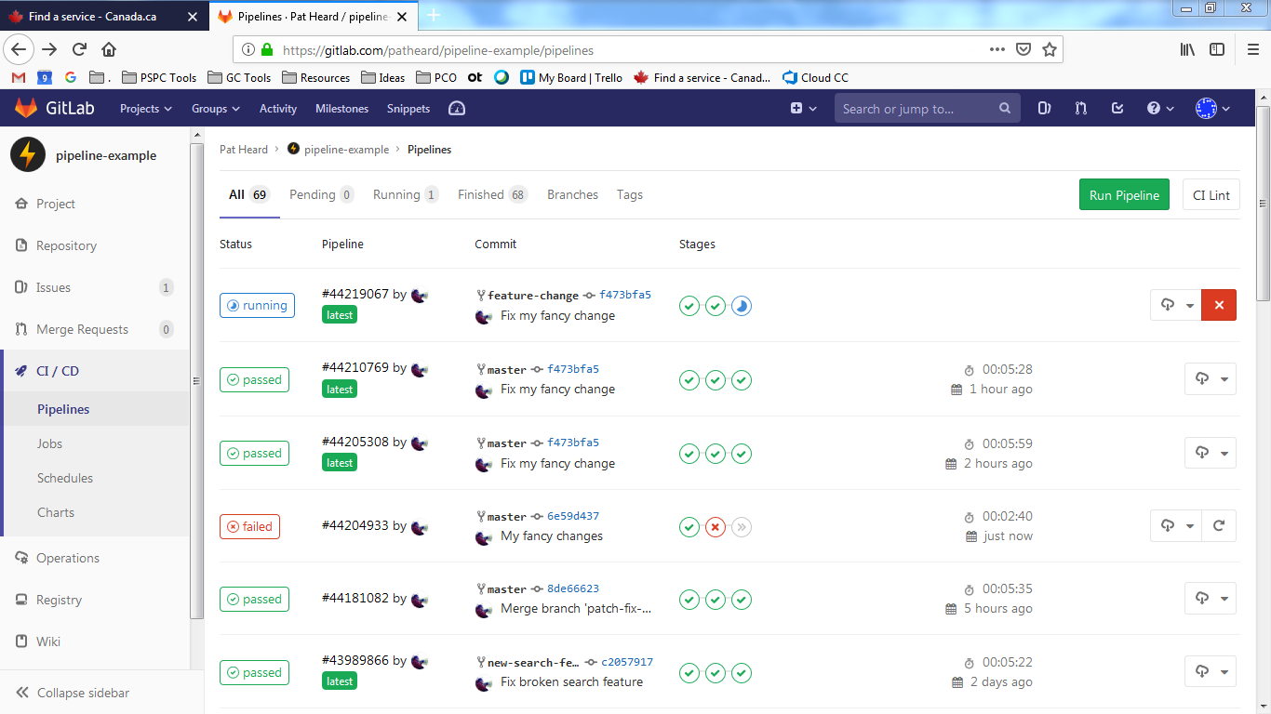
Demo
Notes:
The GitLab pipeline is triggered when the developer saved their code to the Code Repository, and we can see in real time that a Pipeline has been triggered and exactly what state it is in.
If you click on the running popeline, we can get more details on what is in it

Slide 11
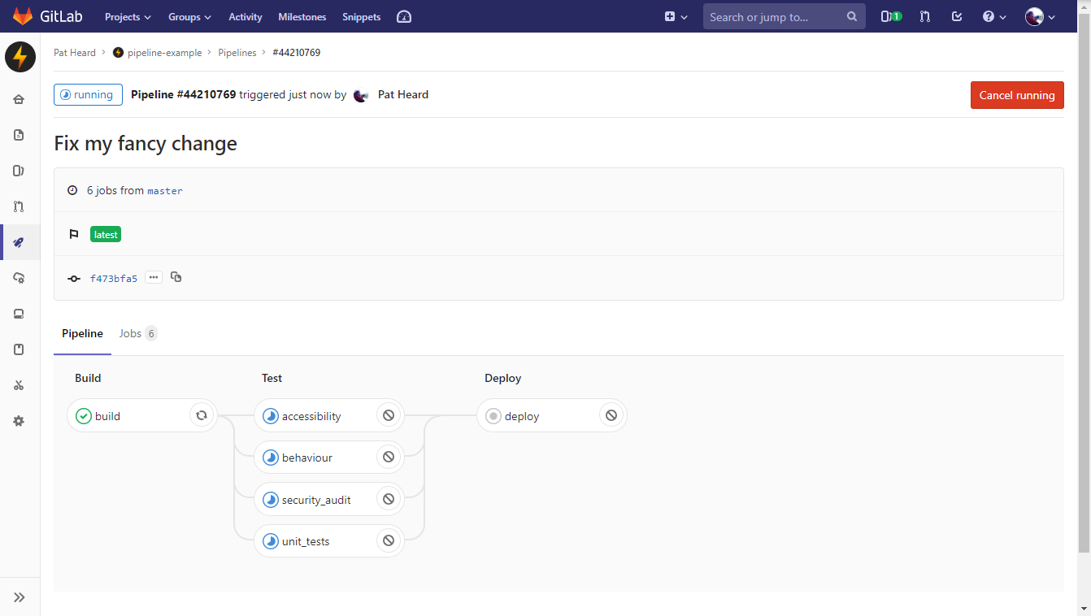
Demo
Automatic Builds
Automatic Testing
Automatic Deploy
Build creates a temporary environment – no longer need expensive testing servers
Repeatable testing tasks that verify the compliance needed to make code shippable
Code is packaged and shipped to production, only if the previous steps finish.
Notes:
We are able to view details about exactly what is in tis pipeline.
For the purposes of our demo, we simulated 4 gates.
Accessibilty – do we meet the automated compliance requirements?
Behaviour or Functional Testing – Is the service working as we expect it to?
Security Audit – Is this build meeting security requirements?
And Automated Unit Tests
We can equate these to the stages on an assembly line floor. In order to get to the last gate (deploy) all the other stages must be successful.

Slide 12
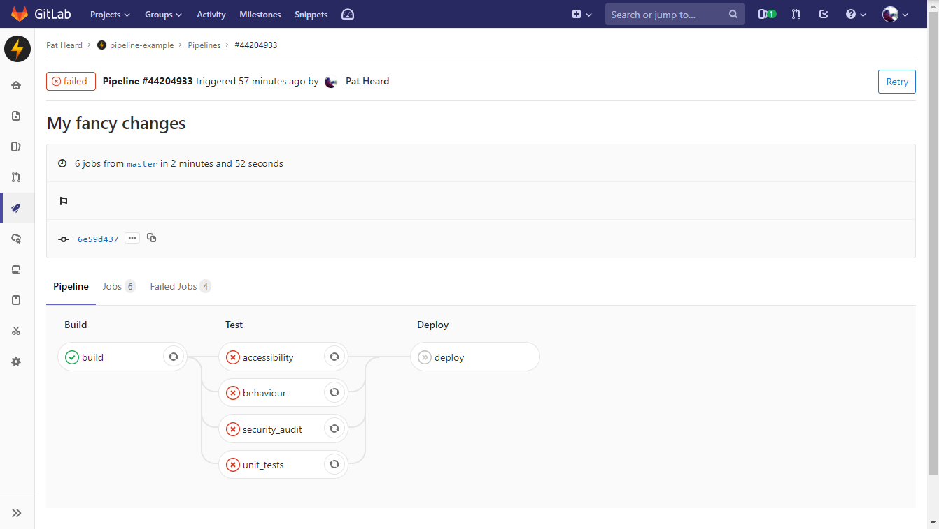
Demo
Notes:
For our simple demo purposes, we had that one change fail everything. Now in a real scenario likely only one, or two might fail and the problem is easily isolated and address. But whats important to note, is that we did not make it to the deploy stage.
Just like in an Andon assmeply line – the pipeline was stopped and this developers code was not pushed to production. Our service stays stable.

Slide 13
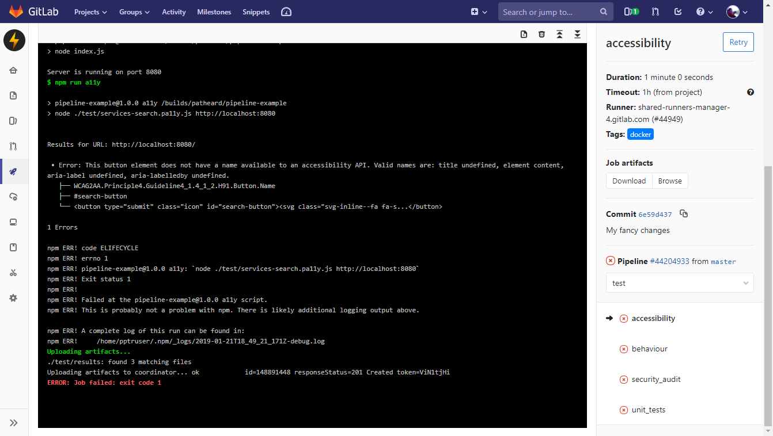
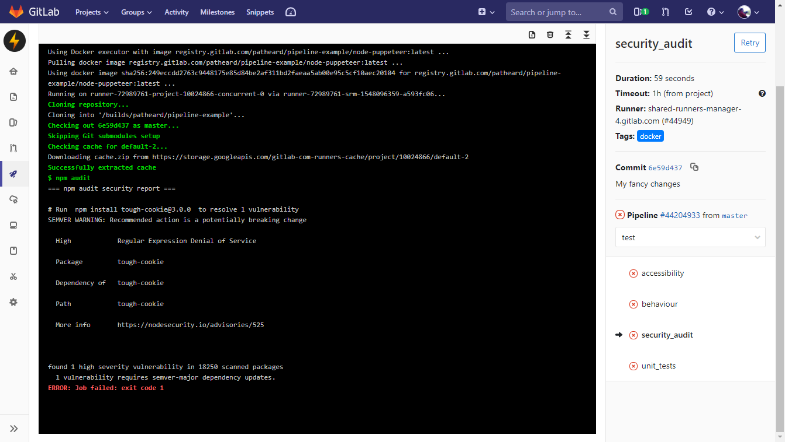
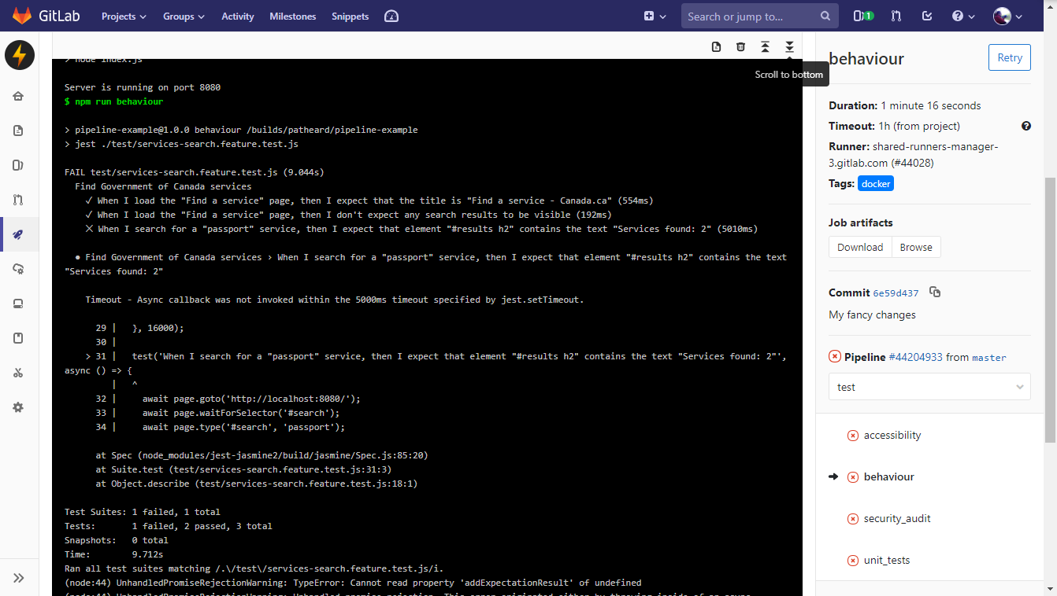
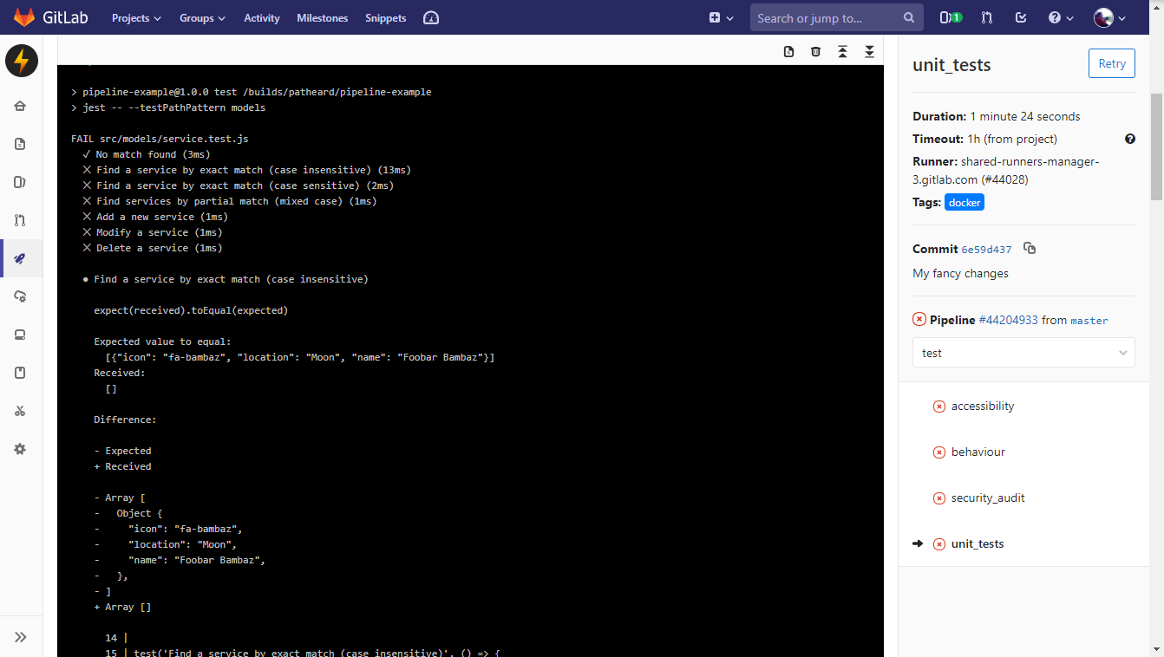
Demo

Slide 14

Demo
Accessibility Automation
Accessibility Current State
Accessibility automation tasks have detected an issue with colour contrast for colour-blind users, and a button label is missing for screen readers.
Development team codes keeping accessibility rules in mind
At the end of a project, team submits their application to be assessed for accessibility compliance right before going live
Lengthy back and fourth between the two teams, often not completed due to time constraints
Instant learning opportunities for developers
Enforces accessibility testing throughout a project, not just the end.
Significant cost and time savings even if we can currently only automate 20% of tests

Slide 15
Demo
Security Current State
Security Automation
Security Team discovers that a vulnerability has been detected in a library that we use in DSB
A manual email is distributed to a large distribution list
Teams try to fix the problem in production, but only if impacted teams receive the notice and react
Security Team has no mechanism to be 100% confident, and the process is a problem for everyone involved.
Security Automation detects, using real time data, that one library has been identified as vulnerable.
Development Teams get instant security feedback
Security Team can be notified of the incident in real time and connect with Development Teams to help triage and fix the issue
Allows security to be continually monitored in real time, instead of only at intervals

Slide 16
Demo
Behaviour Automation
Behaviour Testing Current State
Automated behaviour tests detect that the Search is no longer returning the right results, because the Developer accidentally deleted a line of code.
Development team makes changes to one area of an application, but it breaks something else
Testers execute manual test plans of the impacted pages, but full regression testing can take weeks.
Service breaking bugs not caught by manual tests are left undetected, and are sent to production.
Application breaking code doesn’t make it to production.
Running full regression testing reduced from weeks to hours, with no manual intervention.
We can enable client requirement documents to be used as automated tests

Slide 17
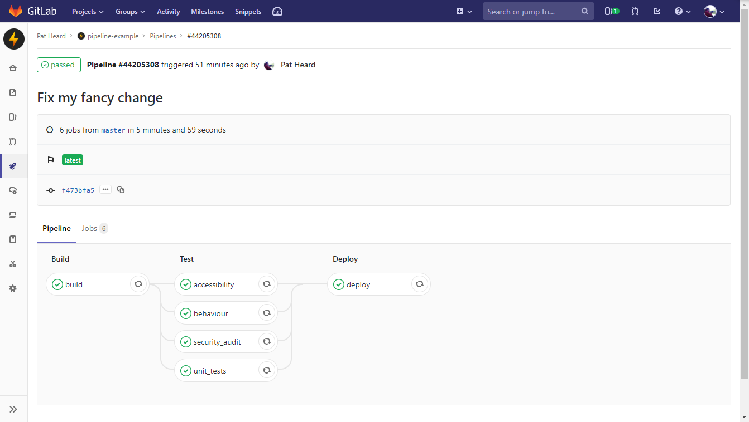

Demo

Slide 18
Demo

Slide 19
What to take away
By automating compliance, we free up their time to allow them to do more
Testers can specialize in test automation
Security can specialize in security automation
Developers and Business Analysts can write Behaviour and Unit Tests
There are a vast amount of free, open source compliance libraries and tools at our disposal
CI/CD pipelines are standard industry practice

Slide 20
Steps to get there
Encourage the use of modern tooling that makes building CI/CD Pipelines much easier:
GitLab, GitLab.com, Bamboo, BitBucket Pipelines
Containers (Docker)
Advocate Cloud adoption where possible, but when not possible form partnership with SSC to support the use of these technology in end-state servers
Invest in our developers in order to increase the maturity of our development practices

Slide 21

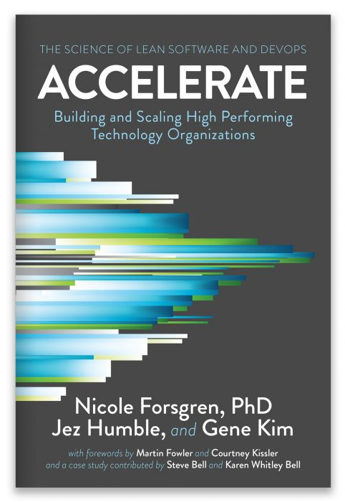
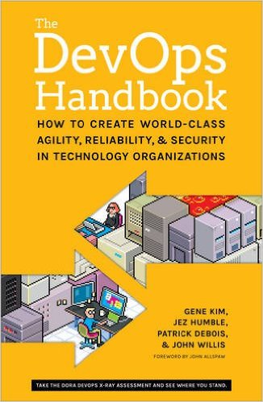
Recommended Reading

